Slide 1
AM Best América Latina
Mercado de Seguros y Reaseguros Latinoamericano.
Visión de las Calificadoras de Riesgo.
Buenos Aires, Argentina, 27 de Mayo de 2026.

Slide 2

Acerca de AM Best
Fundada en 1899, AM Best es la agencia calificadora global líder para la industria
de Seguros, siendo pionera en el concepto de calificar la solidez financiera de las aseguradoras
Proveedor líder de calificaciones, información financiera y noticias sobre la industria de seguros
  Alrededor de 4,000 calificaciones publicadas
  Documentos de investigación y publicaciones periódicas
  Servicios de información y bases de datos
Única agencia calificadora internacional dedicada exclusivamente al sector asegurador y afianzador
  Las metodologías son específicas para el sector
  Los analistas son especialistas en seguros y sólo analizan compañías de seguros y fianzas

Slide 3
Cobertura y liderazgo a nivel mundial.
Calificaciones de fortaleza financiera (FSR) a (re)aseguradoras a nivel global
Fuente: Sitios web de AM Best, S&P, Moody’s y Fitch. Información a Febrero 2026, menos Fitch y Moody´s.

Slide 4
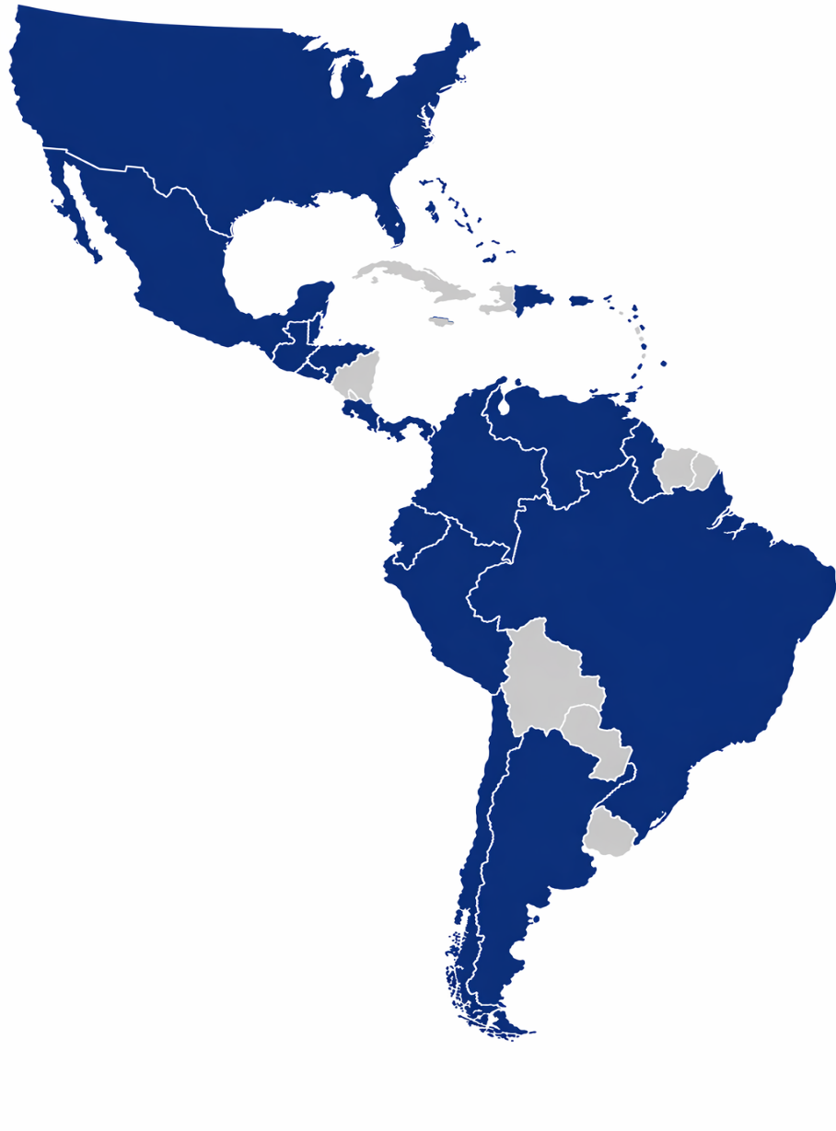
Presencia de AM Best en la región
AM Best América Latina está a cargo del seguimiento de más de 118 compañías, entre aseguradoras, reaseguradoras, cautivas, afianzadoras y MGA´s, en 25 países al día de hoy.

Slide 5
Perspectivas mercado Latinoamericano
1. El mercado de (rea)seguros sigue creciendo, de la mano de la demanda y dinamismo de la región, a pesar de los retos que enfrenta.
2021-2024
COVID-19 y su
recuperación
2025 y +
Panoramas políticos complejos
Políticas monetarias inciertas
Economía global inestable

Slide 6
Perspectivas mercado Latinoamericano
2. Creciente necesidad de reaseguro en el futuro cercano para la región.
Necesidad de Reaseguro
Suscripción especializada
Boom de MGA´s
Apetitos de riesgo cambiantes

Slide 7
Perspectivas mercado Latinoamericano
Rentabilidad atrae nueva capacidad
Tasas bajan por competencia
Tasas se incrementan por escasez
Entrada de capital al mercado
MERCADO DE
OFERTA
Guerra de T&C´s
Tasas bajan por sobreoferta
MERCADO DE DEMANDA
Capacidad escasea en el mercado
Se suscribe más riesgo
Suscripción más restrictiva
Mercado suave
Ciclo del
mercado
re/asegurador
Mercado duro

Slide 8
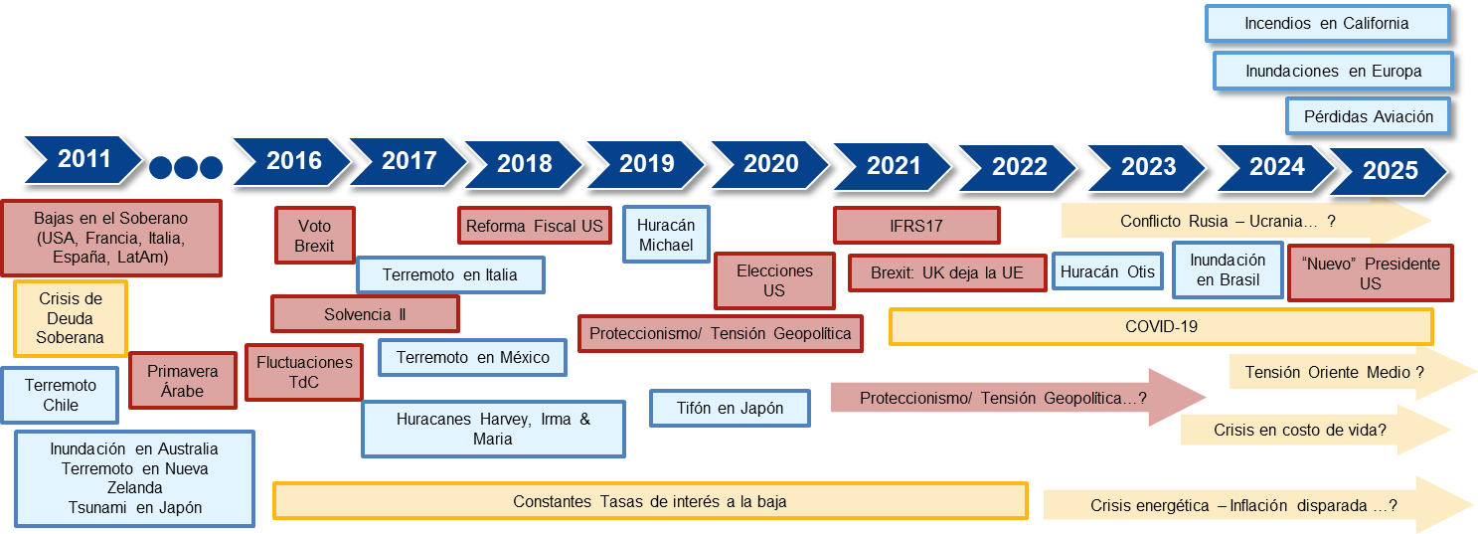
Perspectivas mercado Latinoamericano

Slide 9
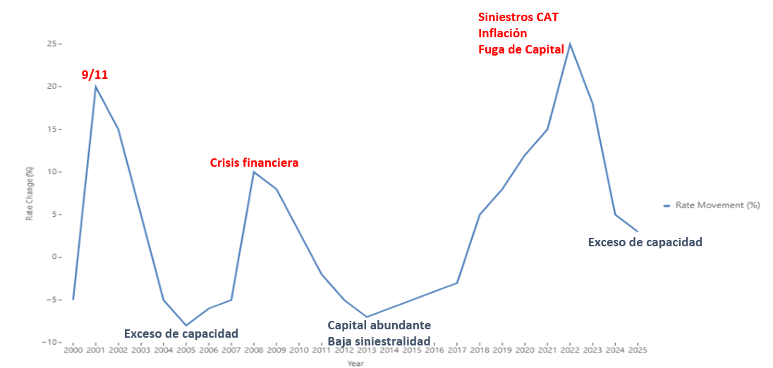
Perspectivas mercado Latinoamericano

Slide 10

Preguntas

Slide 11
© AM Best Company, Inc. (AMB) and/or its licensors and affiliates. All rights reserved. ALL INFORMATION CONTAINED HEREIN IS PROTECTED BY COPYRIGHT LAW AND NONE OF SUCH INFORMATION MAY BE COPIED OR OTHERWISE REPRODUCED, REPACKAGED, FURTHER TRANSMITTED, TRANSFERRED, DISSEMINATED, REDISTRIBUTED OR RESOLD, OR STORED FOR SUBSEQUENT USE FOR ANY SUCH PURPOSE, IN WHOLE OR IN PART, IN ANY FORM OR MANNER OR BY ANY MEANS
WHATSOEVER, BY ANY PERSON WITHOUT AMB’s PRIOR WRITTEN CONSENT. All information contained herein is obtained by AMB from sources believed by it to be accurate and reliable. AMB does not audit or otherwise independently verify the accuracy or reliability of information received or otherwise used and therefore all information contained herein is provided “AS IS” without warranty of any kind. Under no circumstances shall AMB have any liability to any person or entity for (a) any loss or damage in whole or in part caused by, resulting from, or relating to, any error (negligent or otherwise) or other circumstance or contingency within or outside the control of AMB or any of its directors,
officers, employees or agents in connection with the procurement, collection, compilation, analysis, interpretation, communication, publication or delivery of any such information, or (b) any direct, indirect, special, consequential, compensatory or incidental damages whatsoever (including without limitation, lost profits), even if AMB is advised in advance of the possibility of such damages, resulting from the use of or inability to use, any such information. The credit ratings, financial reporting analysis, projections, and other observations, if any, constituting part of the information contained herein are, and must be construed solely as, statements of opinion and not statements of fact or recommendations to purchase, sell or hold any securities, insurance policies, contracts or any other financial obligations, nor does it address the suitability of any particular financial obligation for a specific purpose or purchaser. Credit risk is the risk that an entity may not meet its contractual, financial obligations as they come due. Credit ratings do not address any other risk, including but not limited to, liquidity risk, market value risk or price volatility of rated securities. AMB is not an investment advisor and does not offer consulting or advisory services, nor does the company or its
rating analysts offer any form of structuring or financial advice. NO WARRANTY, EXPRESS OR IMPLIED, AS TO THE ACCURACY, TIMELINESS, COMPLETENESS, MERCHANTABILITY OR FITNESS FOR ANY PARTICULAR PURPOSE OF ANY SUCH RATING OR OTHER OPINION OR INFORMATION IS GIVEN OR MADE BY AMB IN ANY FORM OR MANNER WHATSOEVER. Each credit rating or other
opinion must be weighed solely as one factor in any investment or purchasing decision made by or on behalf of any user of the information contained herein, and each such user must accordingly make its own study and evaluation of each security or other financial obligation and of each issuer and guarantor of, and each provider of credit support for, each security or other financial obligation that it may consider purchasing, holding or selling.
^{Our Insight, Your Advantage™}

